Slide 1
Recursion

Slide 2
Recursion
Objectives:
What is Recursion?
Why do we need Recursion?
The Logic behind the Recursion
Recursive vs Iterative Solutions
How to Write Recursion in 3 Steps?
Find Fibonacci Series using Recursion

Slide 3

What is Recursion?

Slide 4


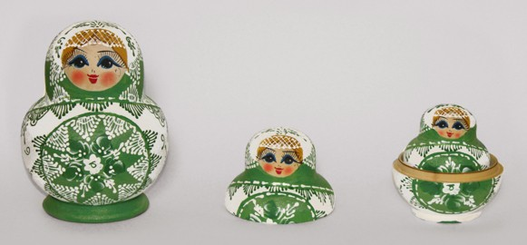
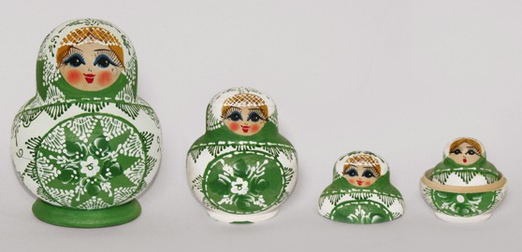

What is Recursion?
Recursion : a way of solving a problem by having a function calling itself
…

Slide 5
What is Recursion?
Recursion : a way of solving a problem by having a function calling itself
Performing the same operation multiple times with different inputs
In every step we try smaller inputs to make the problem smaller.
Base condition is needed to stop the recursion, otherwise infinite loop will occur.

Slide 6
What is Recursion?
Recursion : a way of solving a problem by having a function calling itself
static void openRussianDoll(int doll) { if (doll == 1) {
System.out.println("All dolls are opened");
} else { openRussianDoll(doll-1);
}
}

Slide 7
Why we need Recursion?

Slide 8
Why we need Recursion?
Recursive thinking is really important in programming and it helps you break down big problems into smaller ones and easier to use
when to choose recursion?
If you can divine the problem into similar sub problems
Design an algorithm to compute nth…
Write code to list the n…
Implement a method to compute all.
Practice
The prominent usage of recursion in data structures like trees and graphs.
Interviews
It is used in many algorithms (divide and conquer, greedy and dynamic programming)

Slide 9
The Logic Behind Recursion

Slide 10
The Logic Behind Recursion
A method calls it self
Exit from infinite loop
static string recursionMethod(String[] parameters) { if (exit from condition satisfied) {
return some value;
} else {
recursionMethod(modified parameters);
}
}

Slide 11
The Logic Behind Recursion
static void firstMethod() { secondMethod();
System.out.println("I am the first Method");
}
static void secondMethod() { thirdMethod();
System.out.println("I am the second Method");
}
static void thirdMethod() { fourthMethod();
System.out.println("I am the third Method");
}
static void fourthMethod() { System.out.println("I am the fourth Method");
}
thirdMethod()
secondMethod()
firstMethod()
STACK Memory

Slide 12
The Logic Behind Recursion
static void recursiveMethod(int n) { if (n<1) {
System.out.println("n is less than 1");
} else { recursiveMethod(n-1); System.out.println(n);
}
}
recursiveMethod(1)
recursiveMethod(2)
recursiveMethod(3)
recursiveMethod(4)
recursiveMethod(4) recursiveMethod(3)
recursiveMethod(2) recursiveMethod(1)
4
3
STACK Memory
2
1
n is less than 1
recursiveMethod(0)

Slide 13

Recursive vs Iterative Solutions

Slide 14
Recursive vs Iterative Solutions
Recursive
Iterative
static int powerOfTwo(int n) { if (n==0) {
return 1;
} else {
var power = 2*powerOfTwo(n-1); return power;
}
}
static int powerOfTwoIT(int n) { var i = 0;
var power = 1; while (i < n) {
power = power * 2; i = i + 1;
}
return power;
}
Points | Recursion | Iteration
Space efficient? | No | Yes | No stack memory require in case of iteration
Time efficient? | No | Yes | In case of recursion system needs more time for pop and push elements to stack memory which makes recursion less time efficient
Easy to code? | Yes | No | We use recursion especially in the cases we know that a problem can be divided into similar sub problems.

Slide 15
When to Use/Avoid Recursion?
!

Slide 16
When to Use/Avoid Recursion?
When to use it?
When we can easily breakdown a problem into similar subproblem
When we are fine with extra overhead (both time and space) that comes with it
When we need a quick working solution instead of efficient one
When traverse a tree
When we use memoization in recursion
9
15
23
- preorder tree traversal : 15, 9, 3, 1, 4, 12, 23, 17, 28
3
12
17
28
When avoid it? ¹ ⁴
If time and space complexity matters for us.
Recursion uses more memory. If we use embedded memory. For example an application
that takes more memory in the phone is not efficient
Recursion can be slow

Slide 17
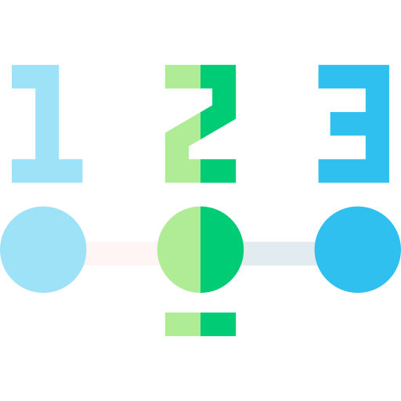
Write Recursion in 3 Steps

Slide 18
Write Recursion in 3 Steps
Factorial
It is the product of all positive integers less than or equal to n.
Denoted by n! (Christian Kramp in 1808).
Only positive numbers.
- 0!=1.
!
Example 1
4! = 4*3*2*1=24
Example 2
10! = 10*9*8*7*6*5*4*3*2*1=36,28,800
n! = n*(n-1)*(n-2)*…*2*1

Slide 19

Write Recursion in 3 Steps
Step 1 : Recursive case - the flow
n! = n * (n-1) * ( n-2) * … * 2 * 1
n! = n * (n-1)!
(n-1)!
(n-1)! = (n-1) * (n-1-1) * (n-1-2) * … * 2 * 1 = (n-1) * (n-2) * (n-3) * … * 2 * 1
Step 2 : Base case - the stopping criterion
0! = 1
1! = 1
Step 3 : Unintentional case - the constraint
factorial(-1) ??
factorial(-2) ??

Slide 20
Write Recursion in 3 Steps
public int factorial(int n) { if (n<0) {
return -1;
}
if (n == 0 || n == 1) { return 1;
}
return n * factorial(n-1);
}
factorial(4) = 24
factorial(4) 6
4 * factorial(3)
2
3 * factorial(2)
2 * factorial(1)
1

Slide 21
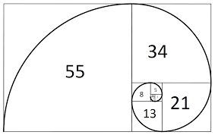
Fibonacci using Recursion

Slide 22
Write Fibonacci Recursion in 3 Steps
Fibonacci numbers
- Fibonacci sequence is a sequence of numbers in which each number is the sum of the two preceding ones and the sequence starts from 0 and 1
0, 1, 1, 2, 3, 5, 8, 13, 21, 34, 55, 89…
Step 1 : Recursive case - the flow
5 = 3 + 2
f(n) = f(n-1) + f(n-2)
Step 2 : Base case - the stopping criterion
0 and 1
Step 3 : Unintentional case - the constraint
fibonacci(-1) ??
fibonacci(1.5) ??

Slide 23
Write Fibonacci Recursion in 3 Steps
public int fibonacci(int n) { if (n < 0) {
return -1;
}
if (n == 0 || n == 1) { return n;
}
return fibonacci(n-1) + fibonacci(n-2);
}
0, 1, 1, 2, 3, 5, 8, 13, 21, 34, 55, 89…
fibonacci(4) =3
2 1
fibonacci(3) + fibonacci(2)
1 0
fibonacci(1) + fibonacci(0)
1
1
fibonacci(2) + fibonacci(1)
1 0
fibonacci(1) + fibonacci(0)

Slide 24

Recursion Interview Questions

Slide 25
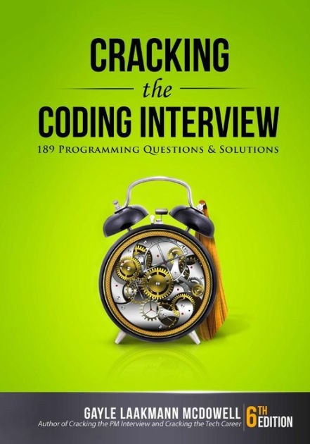





Recursion Interview Questions

Slide 26
Recursion Interview Questions - 1
How to find the sum of digits of a positive integer number using recursion ?
Step 1 : Recursive case - the flow
10 10/10 = 1 and Remainder = 0
54 54/10 = 5 and Remainder = 4
112 112/10 = 11 and Remainder = 2 11/10 = 1 and Remainder = 1
f(n) = n%10 + f(n/10)
Step 2 : Base case - the stopping criterion
n =0
Step 3 : Unintentional case - the constraint
sumofDigits(-11) ?? sumofDigits(1.5) ??

Slide 27
Recursion Interview Questions - 2
How to calculate power of a number using recursion?
Step 1 : Recursive case - the flow
x^{n}=x*x*x*..(n times)..*x
2⁴=2*2*2*2 _{x}a _{* x}b_{=x}a+b _{x}3 _{* x}4_{=x}3+4
x^{n} = x * x^{n-1}
Step 2 : Base case - the stopping criterion
n = 0
n = 1
Step 3 : Unintentional case - the constraint
power(2, 1.2) ??
power(2, -1) ??

Slide 28




Recursion Interview Questions - 3
How to find GCD ( Greatest Common Divisor) of two numbers using recursion?
Step 1 : Recursive case - the flow
GCD is the largest positive integer that divides the numbers without a remainder
gcd(8,12) = 4
8 = 2 * 2 * 2
12 = 2 * 2 * 3
Euclidean algorithm
gcd(48,18)
Step 1 : 48/18 = 2 remainder 12
Step 2 : 18/12 = 1 remainder 6
Step 3 : 12/6 = 2 remainder 0
gcd(a, 0)=a
gcd(a, b) = gcd(b, a mod b)
Step 2 : Base case - the stopping criterion
b = 0
Step 3 : Unintentional case - the constraint
Positive integers

Slide 29
Recursion Interview Questions - 4
How to convert a number from Decimal to Binary using recursion
Step 1 : Recursive case - the flow
Step 1 : Divide the number by 2
Step 2 : Get the integer quotient for the next iteration Step 3 : Get the remainder for the binary digit
Step 3 : Repeat the steps until the quotient is equal to 0
10 to binary
100110
f(n) = n mod 2 + 10 * f(n/2)
Division by 2 | Quotient | Remainder
10/2 | 5 | 0
5/2 | 2 | 1
2/2 | 1 | 0
1/2 | 0 | 1
Division by 2
Quotient
Remainder
13/2
6
1
6/2
3
0
101 * 10 + 0 = 1010
10 * 10 + 1 = 101
1 * 10 + 0 = 10
3/2
1
1
1/2
0
1

